Slide 1
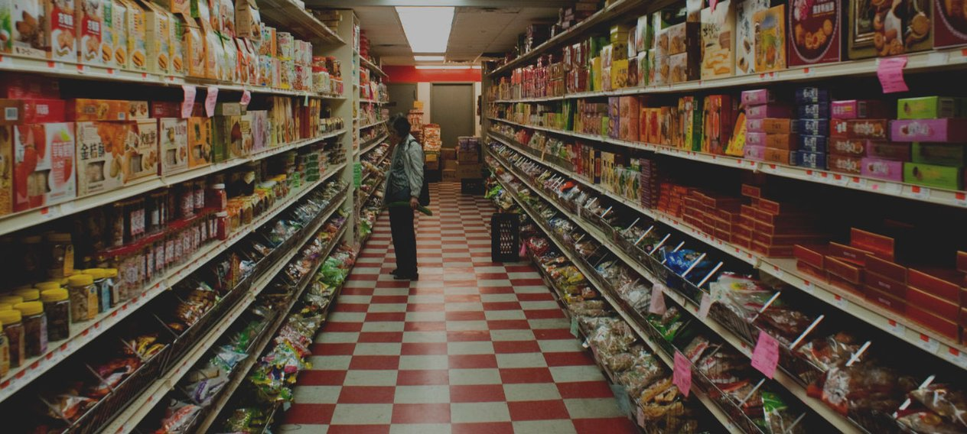
MGT8803 Business Fundamentals for Analytics Video Conference Call #11 Class Exercise – External Analysis of the Supermarket Industry

Slide 2
MGT8803 Business Fundamentals for Analytics Video Conference Call #11 US Supermarket Industry
Statistics
Number of Employees 4.8million
Annual Sales (2017) $682.716billion
Number of supermarkets 38,571
Net profit after Tax 1.1%
Average Store Size 41,300sq ft
Average Number of Items Carried 38,900
Source: Food Marketing Institute (“FMI”)

Slide 3
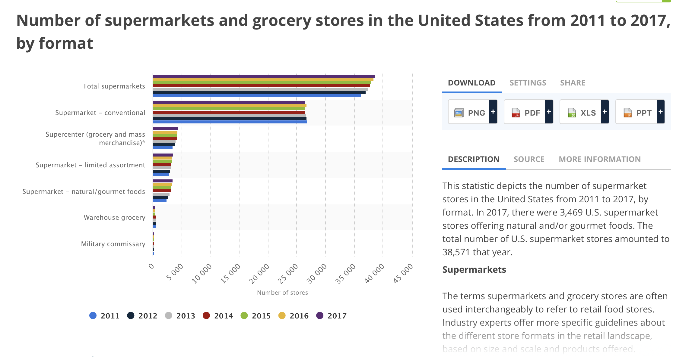
MGT8803 Business Fundamentals for Analytics Video Conference Call #11 US Supermarket Industry
America’s “Best” Supermarket Chains
Wegmans Publix
Trader Joes. Whole Foods
Costco Harris Teeter
Kroger Stew Leonards
New Seasons Market H-E-B
Albertsons Aldi
Meijer Safeway
Giant Food Stop & Shop
Hy-Vee Winn-Dixie
Winco Foods Walmart
Source: The DailyMeal.com
Notes:
This statistic depicts the number of supermarket stores in the United States from 2011 to 2017, by format. In 2017, there were 3,469 U.S. supermarket stores offering natural and/or gourmet foods. The total number of U.S. supermarket stores amounted to 38,571 that year.
Supermarkets The terms supermarkets and grocery stores are often used interchangeably to refer to retail food stores. Industry experts offer more specific guidelines about the different store formats in the retail landscape, based on size and scale and products offered. According to the Food Marketing Institute, supermarkets fall under the traditional grocery segment. They are defined as full-line, self-service grocery stores with generated sales of 2 million U.S. dollars or more per year. Within the category, conventional/traditional supermarkets accounted for the largest share of dollar sales. A conventional supermarket is defined as a store format offering a full-line of groceries, meat, and produce with at least 2 million U.S. dollars in sales. This store format typically carries about 15,000 product items, provides a service deli and frequently offers a service bakery. In addition, up to 15 percent of sales stem from general merchandise (GM)/health and beauty care (HBC). Most of the supermarket dollars were generated from dry grocery food products in 2016. Fresh meat/fish/poultry and fresh produce rounded off the leading product categories within a U.S. supermarket. But how many supermarkets are listed in the United States exactly? The total number of supermarkets amounted to 38,571 in 2017.

Slide 4
MGT8803 Business Fundamentals for Analytics Video Conference Call #11 US Supermarket Industry: Mics Comments from Consumer Reports
Buyer values (from CR): A wide selection, high-quality produce, and good prices are the main attractions, according to CR. But stores that offer an alluring sensory experience while grocery shopping—the scent of cinnamon-­apple pies from the bakery oven, the sight of plump purple and ivory eggplants in a rustic wood case bring us back. But price is and always will be a great motivator. Grocers with the highest scores for competitive prices are for the most part near the top of our ratings. The growing variety of both low- and premium-priced food stores means a dedicated bargain hunter could be the same person frequenting Whole Foods for pricey organic cherries and Walmart for potato chips. People go to different places for different things.
Each month 68 percent of Americans do their grocery shopping at five or more types of food retailers—convenience stores, discount supercenters, farmers markets, specialty/natural-food stores, supermarkets, and warehouse clubs.
Just as the middle class is shrinking, the middle class of grocery stores is being challenged The supermarkets that are doing well are premium stores such as Wegmans, specialty stores like Trader Joe’s, and discounters such as WinCo. “Traditional supermarkets are stuck in the middle,”. According to CR 70 percent of CR readers were either completely or very satisfied with the supermarkets where they do most of their grocery shopping. By contrast, only 48 percent told are completely satisfied with their markets’ healthy offerings, and only 29 percent said the same about the price of their markets’ organic options.
Trends: Smaller footprints, local farm partnerships, meal kits without wait, home delivery, curbside service, and virtual markets

Slide 5


Slide 6
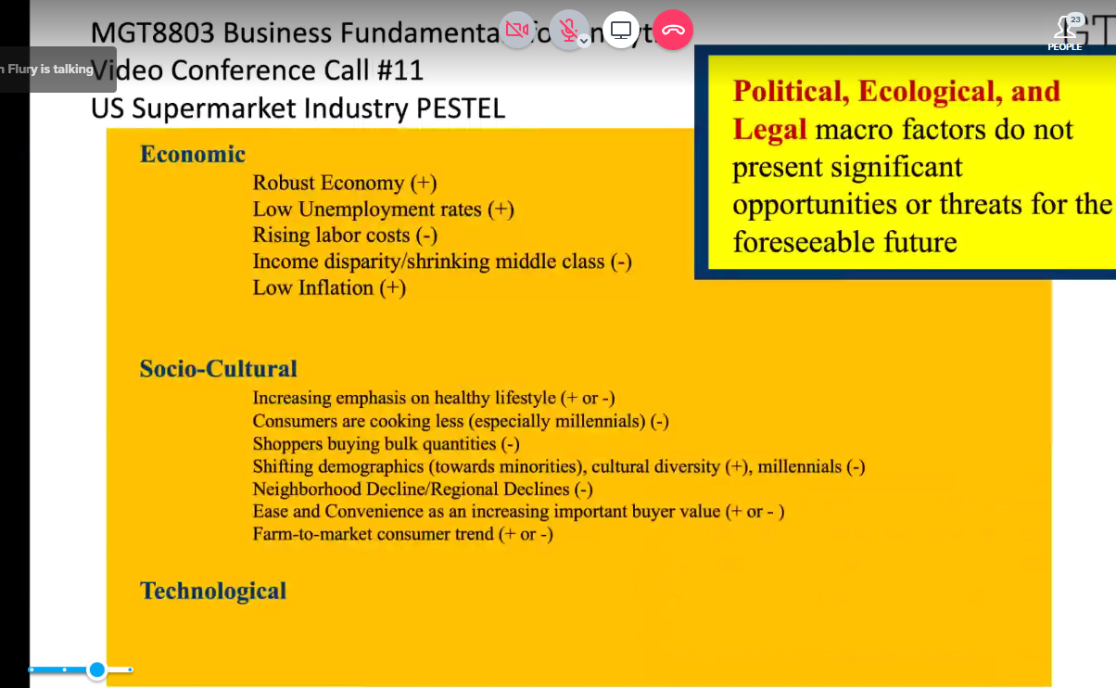

Slide 7


Slide 8


Slide 9
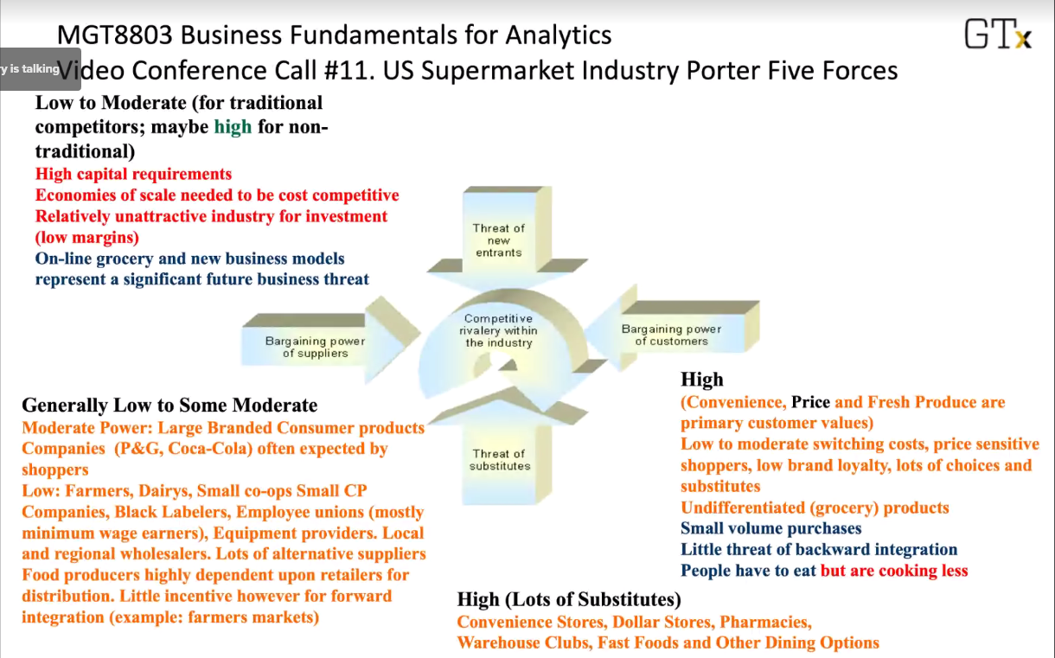

Slide 10
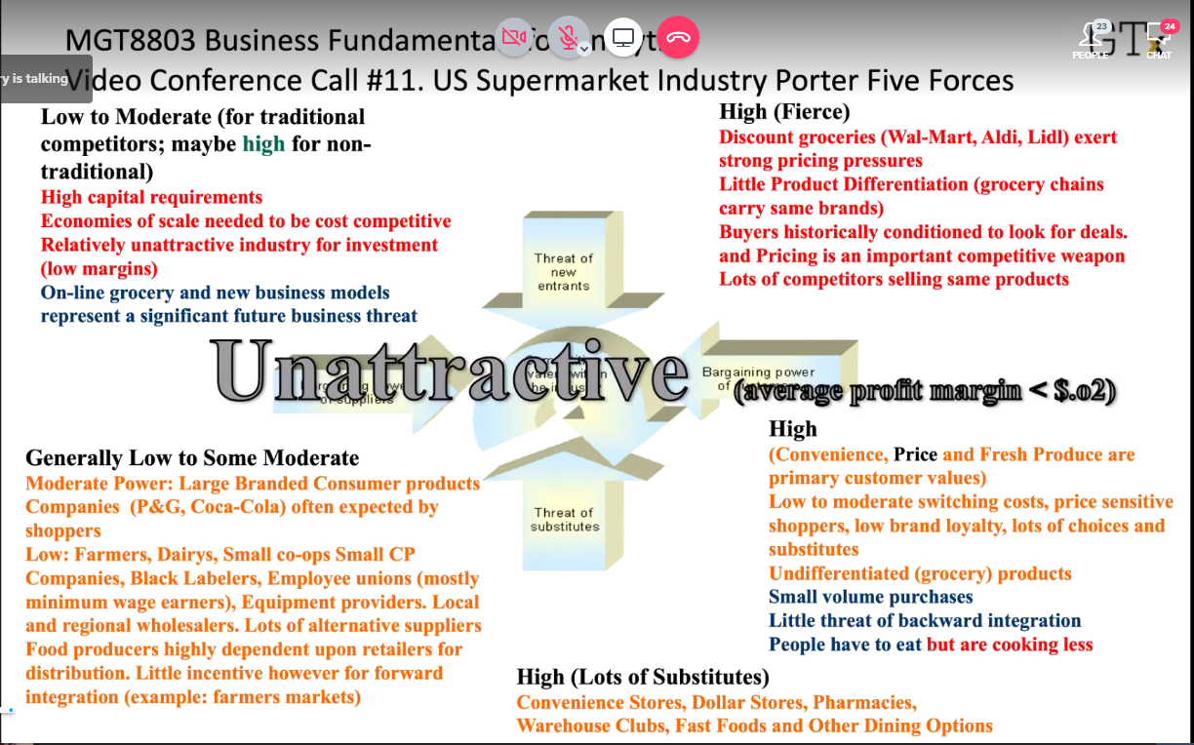

Slide 11
